Slide 1
Insurance cover for grant recipients
The Farmers' Social Insurance Institution Mela 9.2.2026

Slide 2






Mela security for grant recipients
Mela security
for grant recipients
Pension cover (MYEL)
Old age, disability & survivors' pension, rehabilitation allowance
Accident cover (MATA)
For work and leisure time
Group life insurance cover
Work ability services
Mela sickness allowance
Entitlement to Kela cover
Kela sickness allowance, child benefit, parental allowance
Mela insurance premiums • Kela coverage premiums • Taxes

Slide 3
Mela security for grant recipients, example
Accident allowance 90 € /day
+ treatment costs
32,400 euro grant for
12 months
Sickness allowance 68 € /day
(basic allowance 32 € /day)
Old age pension 41 € /month
Kela's earning related benefits e.g. parental allowance 75 € /day
(basic allowance 32 € /day)
4,305 € insurance premiums
+ 148 € leisure time accident insurance
Tax deductible
Kela cover premiums 640 €
Yle tax
Income tax
Total cost ≈ 15 % of grant amount
Notes:
Kelan sairauspäiväraha diassa laskenut viime vuodesta 75->68. Mela-sairauspäiväraha on 63 e/pv // 2025 maksut MYEL 4216,6, MATA 31,54 ja ryhmähenki 6
Klean maksut 1.9% 2025

Slide 4

The basics of MYEL insurance
The insurance is issued for a specific period on a grant-by-grant basis
The criteria for insurance obligation needs to be reviewed for each grant you receive
Length of the insurance period
The duration or length is specified by the grant awarder
Mela provides MYEL insurance for recipients of scientific or artistic grants
The insurance begins on the day the grant work starts
Cannot be earlier than the grant approval date
Grant work can be insured retroactively
For the current year and the preceding year

Slide 5
The insurance is compulsory if…
The grant
You, as a grant recipient
is awarded
  for a minimum work duration of 4 months
  by a Finnish issuer
  for a personal grant, or your personal share of a working group's grant
the grant amount converted into an annual earnings figure amounts to 4 712 € (2026). Minimum grant amount: 1 571 € / 4 months.
are between 18 and 68 years old
  The insurance obligation ends
  at age 69 for those born 1958–1961
  at age 70 for those born in 1962 or later
live in Finland or abroad, but are subject to Finnish social security
are not on an old-age pension
Working part-time or intermittently does not absolve you from the insurance obligation.

Slide 6

The insurance is based on annual earnings 1/2
The annual earnings figure (MYEL earnings)
  is calculated from the personal grant amount in
  relation to the work duration
  confirmed by the insurance decision
  formula: (total grant amount - expenses) x 360 /
  number of working days
Expenses can be deducted from the grant amount if the grant awarder has intended the grant for expenses as well as for work
  Indicate expenses in the insurance application
Normally the annual earnings figure cannot be changed during the insurance period
  index adjustments are made yearly
  If your grant is awarded at least for 12 months, MYEL earnings can be adjusted if certain conditions are met
In the Finnish Pension system all income is converted into annual income.
Notes:
Vuodessa 360 päivää ja kk 30 // indeksi korotus vuosittain 12kk 32.400 ekana vuonna // ½-vuotinen 16.200 -> 32.400

Slide 7
The insurance is based on annual earnings 2/2
MYEL-earnings are the basis of your social security during the insurance period.
It is used to calculate
  MYEL pension accrual, MATA compensation, Mela sickness allowance
  benefits paid by Kela, such as parental and sickness allowances
Insurance payments are based on the length of the insurance
  MYEL earnings are always calculated on an annual basis, even if your grant period is shorter than one year.
  Example
    An 8 000 euro grant with a 4-month working period is considered
    as an annual income of 24 000 euros
    Payments are, however, only collected for the 4-month duration.

Slide 8

Insurance premiums
Calculated according to your age and annual MYEL earnings
13-14 % of the grant amount
1–4 invoices per year
The invoicing period is three months
Due dates are 15/3, 15/6, 15/9, 15/12
Every grant is invoiced separately
A retrospective insurance period is always invoiced at once
Wish to negotiate a payment schedule? Please contact us.
MYEL insurance
premiums are
tax deductible
Other payments related to MYEL insurance
Healthcare contribution (1,98 % in 2026)
Public broadcasting tax

Slide 9
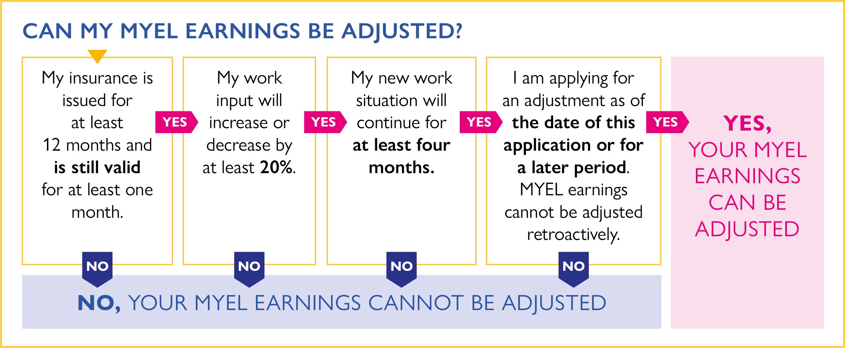
Adjusting MYEL earnings in the middle of the insurance period

Slide 10

Interrupting the insurance or working periodically
The insurance can be interrupted when
the work is interrupted due to paid employment, illness or rehabilitation, childbirth or care of a child under the age of 3, military or civilian service or other similar reason
The interruption is effective from the beginning of the following month, or at the earliest, 4 months from the start of employment
If a grant is awarded for 8 months or less, the insurance cannot be interrupted.
The grant work can be interrupted for at least 4 months
The remaining amount of grant months after the interruption must be at least 4
If a portion of the grant is cancelled and the grant work end prematurely, insurance can be terminated accordingly

Slide 11
Planning to interrupt? Please inform us.
If you plan on working periodically or are aware of an upcoming interruption when applying for
MYEL-insurance
  Report it to Mela in the insurance application
  Send us a message through Mela´s e-services
If you have already received an insurance decision from Mela
  Notify Mela using the form Application due to a change in circumstances (Mela’s e-services)
Remember to attach an approval from the grant awarder
  Grant certificate or a copy of an e-mail

Slide 12
Combining grants
A new grant can be added to an existing insurance, if…
The grant is awarded for the same purpose by the same issuer or working group
It has been awarded at the same time or after the insured grant
Please apply for combining before
the new grant period ends
Work on the new grant takes place at the same time or immediately after the insured grant
The new grant is intended for a minimum of 1 month's but
less than 4 months' duration
The annual earnings figure exceeds the insurance treshold

Slide 13

Working abroad
MYEL insurance is confirmed when
your grant work meets the overall insurance criteria
you are subject to Finnish social security legislation during grant work
The competent authorities are Finnish Centre for
Pensions (ETK), Kela and Mela
Please remember inform us where you work
The rules depend on where you work (EU/other countries)
  EU/EEA-country, UK or Switzerland
  Social security agreement country
  Non-agreement country

Slide 14
Notification obligations
The grant awarder notifies Mela of his grants
Mela takes the insurance decision based on the notification latest when the award payment start
Mela takes the insurance decision based on the notification
  Mela can not confirm an insurance which goes against the notification
  Mela supervises uninsured grant notifications subsequently
The grant recipient applies for the insurance when the grant work begins
If any changes are made, the grant recipient must inform Mela of what has been agreed on with the grant issuer (in writing)
If Mela does not receive an insurance application on time, the insurance decision will be made based on the grant awarder’s notification

Slide 15
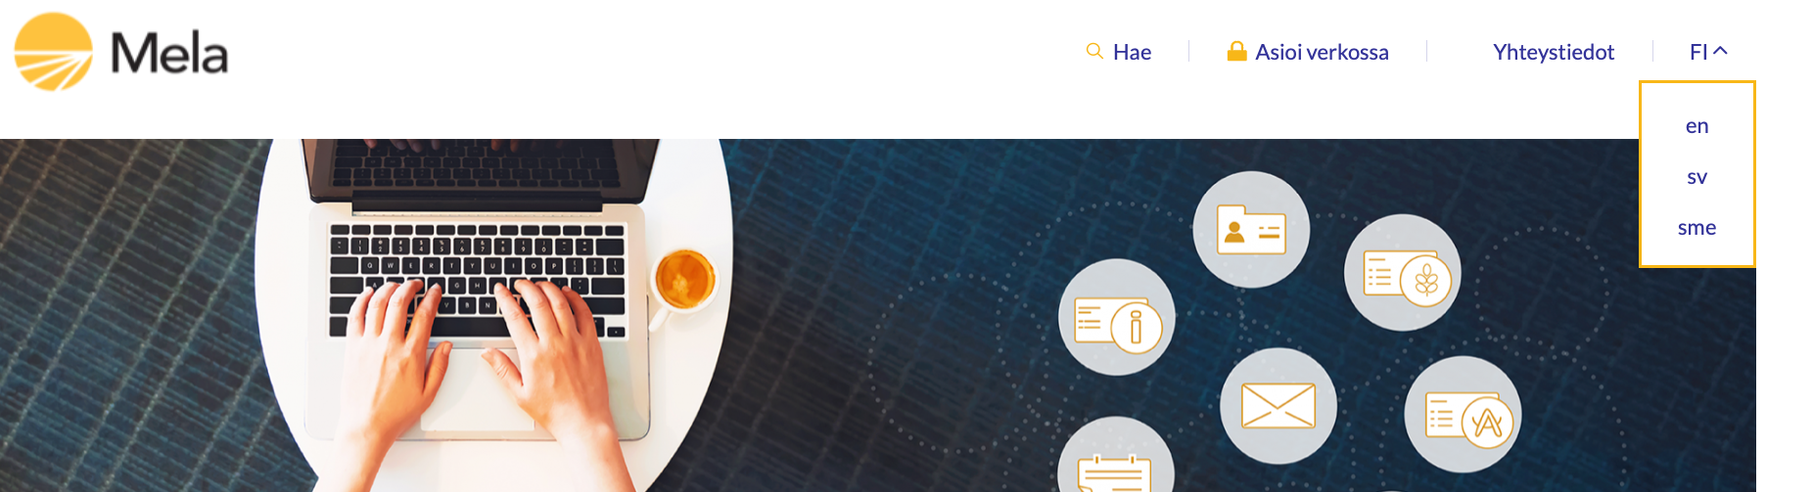

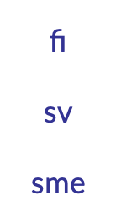
Apply for insurance when you start your grant work
By making an application you can report
  the starting date of grant work
  possible work-related expenses.
If you do not file an insurance application, Mela will issue a decision solely based on the grant awarders notification.
Apply for
your MYEL insurance in Mela´s
e-services
Mela’s e-Services
Notes:
ASEMOINTI

Slide 16
How to apply for insurance?
Notification
from
grant issuer
Grant decision
Mela’s e-services
Insurance application
Insurance decision by Mela
Insurance invoice
New grant
Plan to work abroad?
New application
apply for Finnish social security coverage
(A1 Certificate) from the Finnish Centre for Pensions > etk.fi

Slide 17

Take care of your Mela-security online
Online 24/7
In Mela’s e-services you can
Fill out insurance applications and sign pre-filled applications
Submit a claim in case of an accident at work or during leisure time
Apply for Mela-sickness allowance
Apply for old age pension, disability and survivors' pension, rehabilitation allowance
View your applications and decisions
Send documents and messages to Mela
Print or order certificates
View your Pension record
Update address and bank information
View amounts of made insurance payments and received benefits
Apply for term for payment and view your payment situation

Slide 18
Smooth Use of the e-Service
Mela’s e-service is a secure and convenient way to send messages and manage your insurance matters
Keep your contact details up to date — especially your phone number and email address.
Mela uses your phone number or email address to notify you when we need additional information regarding your insurance matter — helping things proceed smoothly without delays.
Give your consent to receive notifications about new customer messages:
  Choose whether you want to receive notifications about new messages in the online service by text message or email.

Slide 19


Further information
Mela’s website mela.fi/grantrecipient
E-services mela.fi/e-services
  Send and receive messages over a secure connection
Customer service 029 435 2650
Occupational wellbeing services
mela.fi/occupational-wellbeing
mela.fi

