Slide 2
Draft script
Based on this draft script, plan your own discussion and your own preferred way of phrasing the facilitation.
Duration: 120 or 180 min

Slide 3
Instructions for using the script
Plan the dialogue in advance using the script.
You can also use the Timeout dialogue cards to support your planning and the dialogue:
https://www.timeoutdialogue.fi/tool/cards-for-facilitating-a-discussion/
The script supports facilitating the dialogue, do not distribute it to the participants. But do print a copy of the script for yourself after you have modified it to suit yourself and your dialogue.
The wordings of the script are examples. Edit them to better suit the topic of the dialogue, your target group and for yourself.
The times are indicative. They are intended to give an idea of how much time to spend on each stage. With the exception of the start and the end, you do not have to follow exact timings.
You can use your own facilitator competence and, if necessary, use tried and tested methods to support discussions and participants.
Decide before the dialogue who will be the notetaker. It is important to take notes of the whole dialogue. The notetaker does not need to edit the notes afterwards. The idea is to record as precisely as possible what was said during the discussion. The script can help the notetaker to prepare for the dialogue.

Slide 4
Start (1/2)
Welcome to the Great Forest Dialogue Day. Today, our theme is “The meaning and future of the forest for forest owners/campers/ hikers/ Rovaniemi residents/ our classroom/our work community”. Edit this to match the title of your conversation.
The aim is to make visible the meanings, values and hopes and fears of relating to forests.
I am XX and will act as a facilitator in this dialogue, making sure that we all have as equal a discussion as possible, so that everyone has a chance to participate. In practice, this means, for example, that if you talk over each other or do monologues, I will interrupt you. Is that OK with everyone?
Dialogue is a specific way of talking and focuses on deepening our understanding of the issue, of others and of ourselves. It's not about winning or having the best point of view, but about focusing on understanding.
Continued on next page...
(Ask the discussants to arrive well before the start.)
Minutes Time Section
5 12.00 Start
5 12.05 Ground rules and confidentiality
3 12.10 Introductions
5 12.13 Getting ready for the discussion
46 12.18 Discussion
40 13.04 Deepening the discussion
4 13.44 Summing up alone
10 13.48 Short debriefing
2 13.58 Thank you
0 14.00 Closing
Total 120 min (all times are approximate times). If the discussion is 180 min, add more time for deepening the discussion, summarising and debriefing.
Regular text – example wording
Italics – to help the moderator in the discussion
Bold – Change as needed

Slide 5
Start (1/2)
(Ask the discussants to come 15 minutes before the start to test the technique or have coffee and settle in.)
Minutes Time Section
5 12.00 Start
5 12.05 Ground rules and confidentiality
3 12.10 Introductions
5 12.13 Getting ready for the disussion
46 12.18 Discussion
40 13.04 Deepening the discussion
4 13.44 Summing up alone
10 13.48 Short debriefing
2 13.58 Thank you
0 14.00 Closing
Total 120 min (all times are approximate times). If the discussion is 180 min, add more time for deepening the discussion, summarising and debriefing.
Regular text – example wording
Italics – to help the moderator in the discussion
Bold – Change as needed
XX will act as a notetaker and writes down what you say as word for word as possible, but without writing down the names. The transcript will be used as material for the summary of the Great Forest Dialogue Day and for alternative scenarios on the future of forests in Finland. The summary and scenarios will be done in such a way that no individual discussant can be identified.
We have two hours. We will start with an introduction of the theme and pair discussion. Most of the time will be used for a joint discussion and then a little summary at the end. We will finish at xx.xx o’clock.

Slide 6
Rules for a constructive discussion
Ground rules and confidentiality (1/2)
The Timeout rules for constructive discussion will be used in todays’ dialogue. Let's go over them briefly.
The facilitator may print a few copied of the rules to the middle of the ring.
1. Try to listen with an intent to understand what the other person is trying to say, not with the intent to find a space where you can stick in your comment.
2. Try to join in and relate with what others are saying and thinking.
3. As you. listen to each other, different experiences (thoughts, feelings, perceptions, memories, imaginings of the future) may arise to you in that moment. Share them out loud and you are likely to go deeper into a conversation that has not already been had.
4. You can ask questions and address others directly. As the facilitator, I will give you turns to speak.
5. Let's focus on this moment. No looking at your phone or laptop during the discussion. Talk to other people with respect, even if you disagree with them. Other people’s features, sexuality, gender or ethnicity are not things to disagree about.
6. The dialogue is meant to be a situation where we can also explore any contradictions that arise. You don't have to agree on things. Different perspectives enrich the discussion and help us to better understand the subject of the dialogue.
Can we commit to these rules together?
1. Listen to others, do not interrupt or start additional discussions.
2. Relate what you say to what the othes have said and use everyday language.
3. Talk about your own experience.
4. Speak to others directly and ask about their views.
5. Be present and respect others and the atmosphere of trust.
6. Search and bring things together. Boldly deal with emerging conflicts and look for issues that have gone unnoticed.

Slide 7
Minutes Time Section
5 12.00 Start
5 12.05 Ground rules and confidentiality
3 12.10 Introductions
5 12.13 Getting ready for the discussion
46 12.18 Discussion
40 13.04 Deepening the discussion
4 13.44 Summing up alone
10 13.48 Short debriefing
2 13.58 Thank you
0 14.00 Closing
Regular text – example wording
Italics – to help the moderator in the discussion
Bold – Change as needed
Ground rules and confidentiality (2/2)
Let's now agree on the confidentiality of the discussion We hope that you will continue the discussion after this event as well. We ask that that no individual discussant can be identified from the comments or quotes in these discussions. Is this all right with everyone?
Acknowledgement from all.

Slide 8
Minutes Time Section
5 12.00 Start
5 12.05 Ground rules and confidentiality
3 12.10 Introductions
5 12.13 Getting ready for the discussion
46 12.18 Discussion
40 13.04 Deepening the discussion
4 13.44 Summing up alone
10 13.48 Short debriefing
2 13.58 Thank you
0 14.00 Closing
Regular text – example wording
Italics – to help the moderator in the discussion
Bold – Change as needed
Introductions
Let's do a quick round of introductions. Your name and where you're from is enough.
(You can say: Let's not spend more than a moment on this so we can have a proper discussion on the actual topic.)
Let's start here, please.

Slide 9
Minutes Time Section
5 12.00 Start
5 12.05 Ground rules and confidentiality
3 12.10 Introductions
5 12.13 Getting ready for the discussion
46 12.18 Discussion
40 13.04 Deepening the discussion
4 13.44 Summing up alone
10 13.48 Short debriefing
2 13.58 Thank you
0 14.00 Closing
Regular text – example wording
Italics – to help the moderator in the discussion
Bold – Change as needed
Getting ready for the discussion
Use either the ready-made introductory materials or the official introductory video.
Let’s attune to the dialogue with the following video/music/text.
You can also introduce the topic yourself. You can use a current news item, article, snapshot, experience, research or other material related to the topic that suits your group of participants and stimulate the discussion with it.

Slide 10
Minutes Time Section
5 12.00 Start
5 12.05 Ground rules and confidentiality
3 12.10 Introductions
5 12.13 Getting ready for the discussion
46 12.18 Discussion
40 13.04 Deepening the discussion
4 13.44 Summing up alone
10 13.48 Short debriefing
2 13.58 Thank you
0 14.00 Closing
Regular text – example wording
Italics – to help the moderator in the discussion
Bold – Change as needed
Dicussion: kickstart with a pair
Divide the group into pairs/threes. Clearly state who is paired with whom. If there are only three people in the group, you can discuss the first ideas with the whole group. You can start the facilitation without any material directly with a discussion in pairs.
Start the discussion with pair discussions (or a group of three).
Opening question: What personal experiences the does the introduction evoke in you. How does it relate to what the forest means to you personally?
Alternative starter question: What does the forest mean to you personally? It can be anything: hiking, pictures, a nature documentary, a home, an urban forest, animals, plants, economy, work, values, or something else entirely. Let's try to get as much variety as possible out of what the forest means to each of us.
Make sure that both get to have a say. You have three minutes. You can start ... Now it's time to stop.

Slide 11
Minutes Time Section
5 12.00 Start
5 12.05 Ground rules and confidentiality
3 12.10 Introductions
5 12.13 Getting ready for the discussion
46 12.18 Discussion
40 13.04 Deepening the discussion
4 13.44 Summing up alone
10 13.48 Short debriefing
2 13.58 Thank you
0 14.00 Closing
Regular text – example wording
Italics – to help the moderator in the discussion
Bold – Change as needed
Now I want to hear what you and the pair talked about and what thoughts came up. The group who is ready can start.
Tell me what you talked about and what thoughts came up. What other experiences came up?
At this point, it is a good idea to ask each participant a question to let them know that everyone’s participation in the dialogue matters.
After the pair discussions, continue together as a group: Now that you have listened to each other, what thoughts/feelings, possible questions have come up?
Try to pick up on the themes that emerge in the discussion and come up with further questions based on them.
You can summarise some of the themes that emerged: you raised at least the following issues xx, xx and xx
You can also look at some or all of the forest-related fact sheets if the discussion tends to get off-track or cannot lift off.

Slide 12
Minutes Time Section
5 12.00 Start
5 12.05 Ground rules and confidentiality
3 12.10 Introductions
5 12.13 Getting ready for the discussion
46 12.18 Discussion
40 13.04 Deepening the discussion
4 13.44 Summing up alone
10 13.48 Short debriefing
2 13.58 Thank you
0 14.00 Closing
Regular text – example wording
Italics – to help the moderator in the discussion
Bold – Change as needed
Deepening the discussion: looking
into the future
Think in advance about how far into the future you are asking participants to imagine. It would be good if the time frame for the future is somewhere between 5 and 20 years.
Key additional questions (adapt them to your liking!)
What kind of future do you want for forests? What kind of future do you fear?
Try to imagine in concrete terms what the future forest will be like. What will it look and feel like? Who will be there? What kind of life will there be in the forests in the future? How will the forest of the future affect people? Or society as a whole?
How have we arrived at this situation?
Let the discussion flow on its own. Avoid it turning into an interview.
Make sure that the quieter people can have their say and that the more active ones are not in the center all the time.

Slide 13
Minutes Time Section
5 12.00 Start
5 12.05 Ground rules and confidentiality
3 12.10 Introductions
5 12.13 Getting ready for the discussion
46 12.18 Discussion
40 13.04 Deepening the discussion
4 13.44 Summing up alone
10 13.48 Short debriefing
2 13.58 Thank you
0 14.00 Closing
Regular text – example wording
Italics – to help the moderator in the discussion
Bold – Change as needed
Summing up alone
Everyone should have a piece of paper and a paper under their chair before the discussion. At this point, ask everyone to write on that paper.
As an individual task, write 1–3 ideas or points, in complete sentences, that are somehow significant or central to you from the discussions. We will collect these notes anonymously for the note keeping so that any individuals cannot be identified from them.
You have three minutes and it starts now.
Now the three minutes have passed.

Slide 14
Minutes Time Section
5 12.00 Start
5 12.05 Ground rules and confidentiality
3 12.10 Introductions
5 12.13 Getting ready for the discussion
46 12.18 Discussion
40 13.04 Deepening the discussion
4 13.44 Summing up alone
10 13.48 Short debriefing
2 13.58 Thank you
0 14.00 Closing
Regular text – example wording
Italics – to help the moderator in the discussion
Bold – Change as needed
Short debriefing
Ask each person in turn to read a sentence they have written.
Let's start with you. What has been significant for you in some way about this conversation?
If there is time, pick up a few highlights of what the conversation has been like for the participants in their own words.
Finally, let's go over a bit of what this discussion has been like for you. Your experiences may well be very different. Whoever is ready can start.

Slide 15
Minutes Time Section
5 12.00 Start
5 12.05 Ground rules and confidentiality
3 12.10 Introductions
5 12.13 Getting ready for the discussion
46 12.18 Discussion
40 13.04 Deepening the discussion
4 13.44 Summing up alone
10 13.48 Short debriefing
2 13.58 Thank you
0 14.00 Closing
Regular text – example wording
Italics – to help the moderator in the discussion
Bold – Change as needed
Thank you and closing
Now it's time to end our discussion.
An anonymous summary of all the discussions from the Great Forest Dialogue Day, as well as alternative scenarios for the future of forests will be published on the Kone Foundation website during the fall.
Thank you for a fruitful discussion! We hope you will continue the discussion that has now begun even after this event.

Slide 16
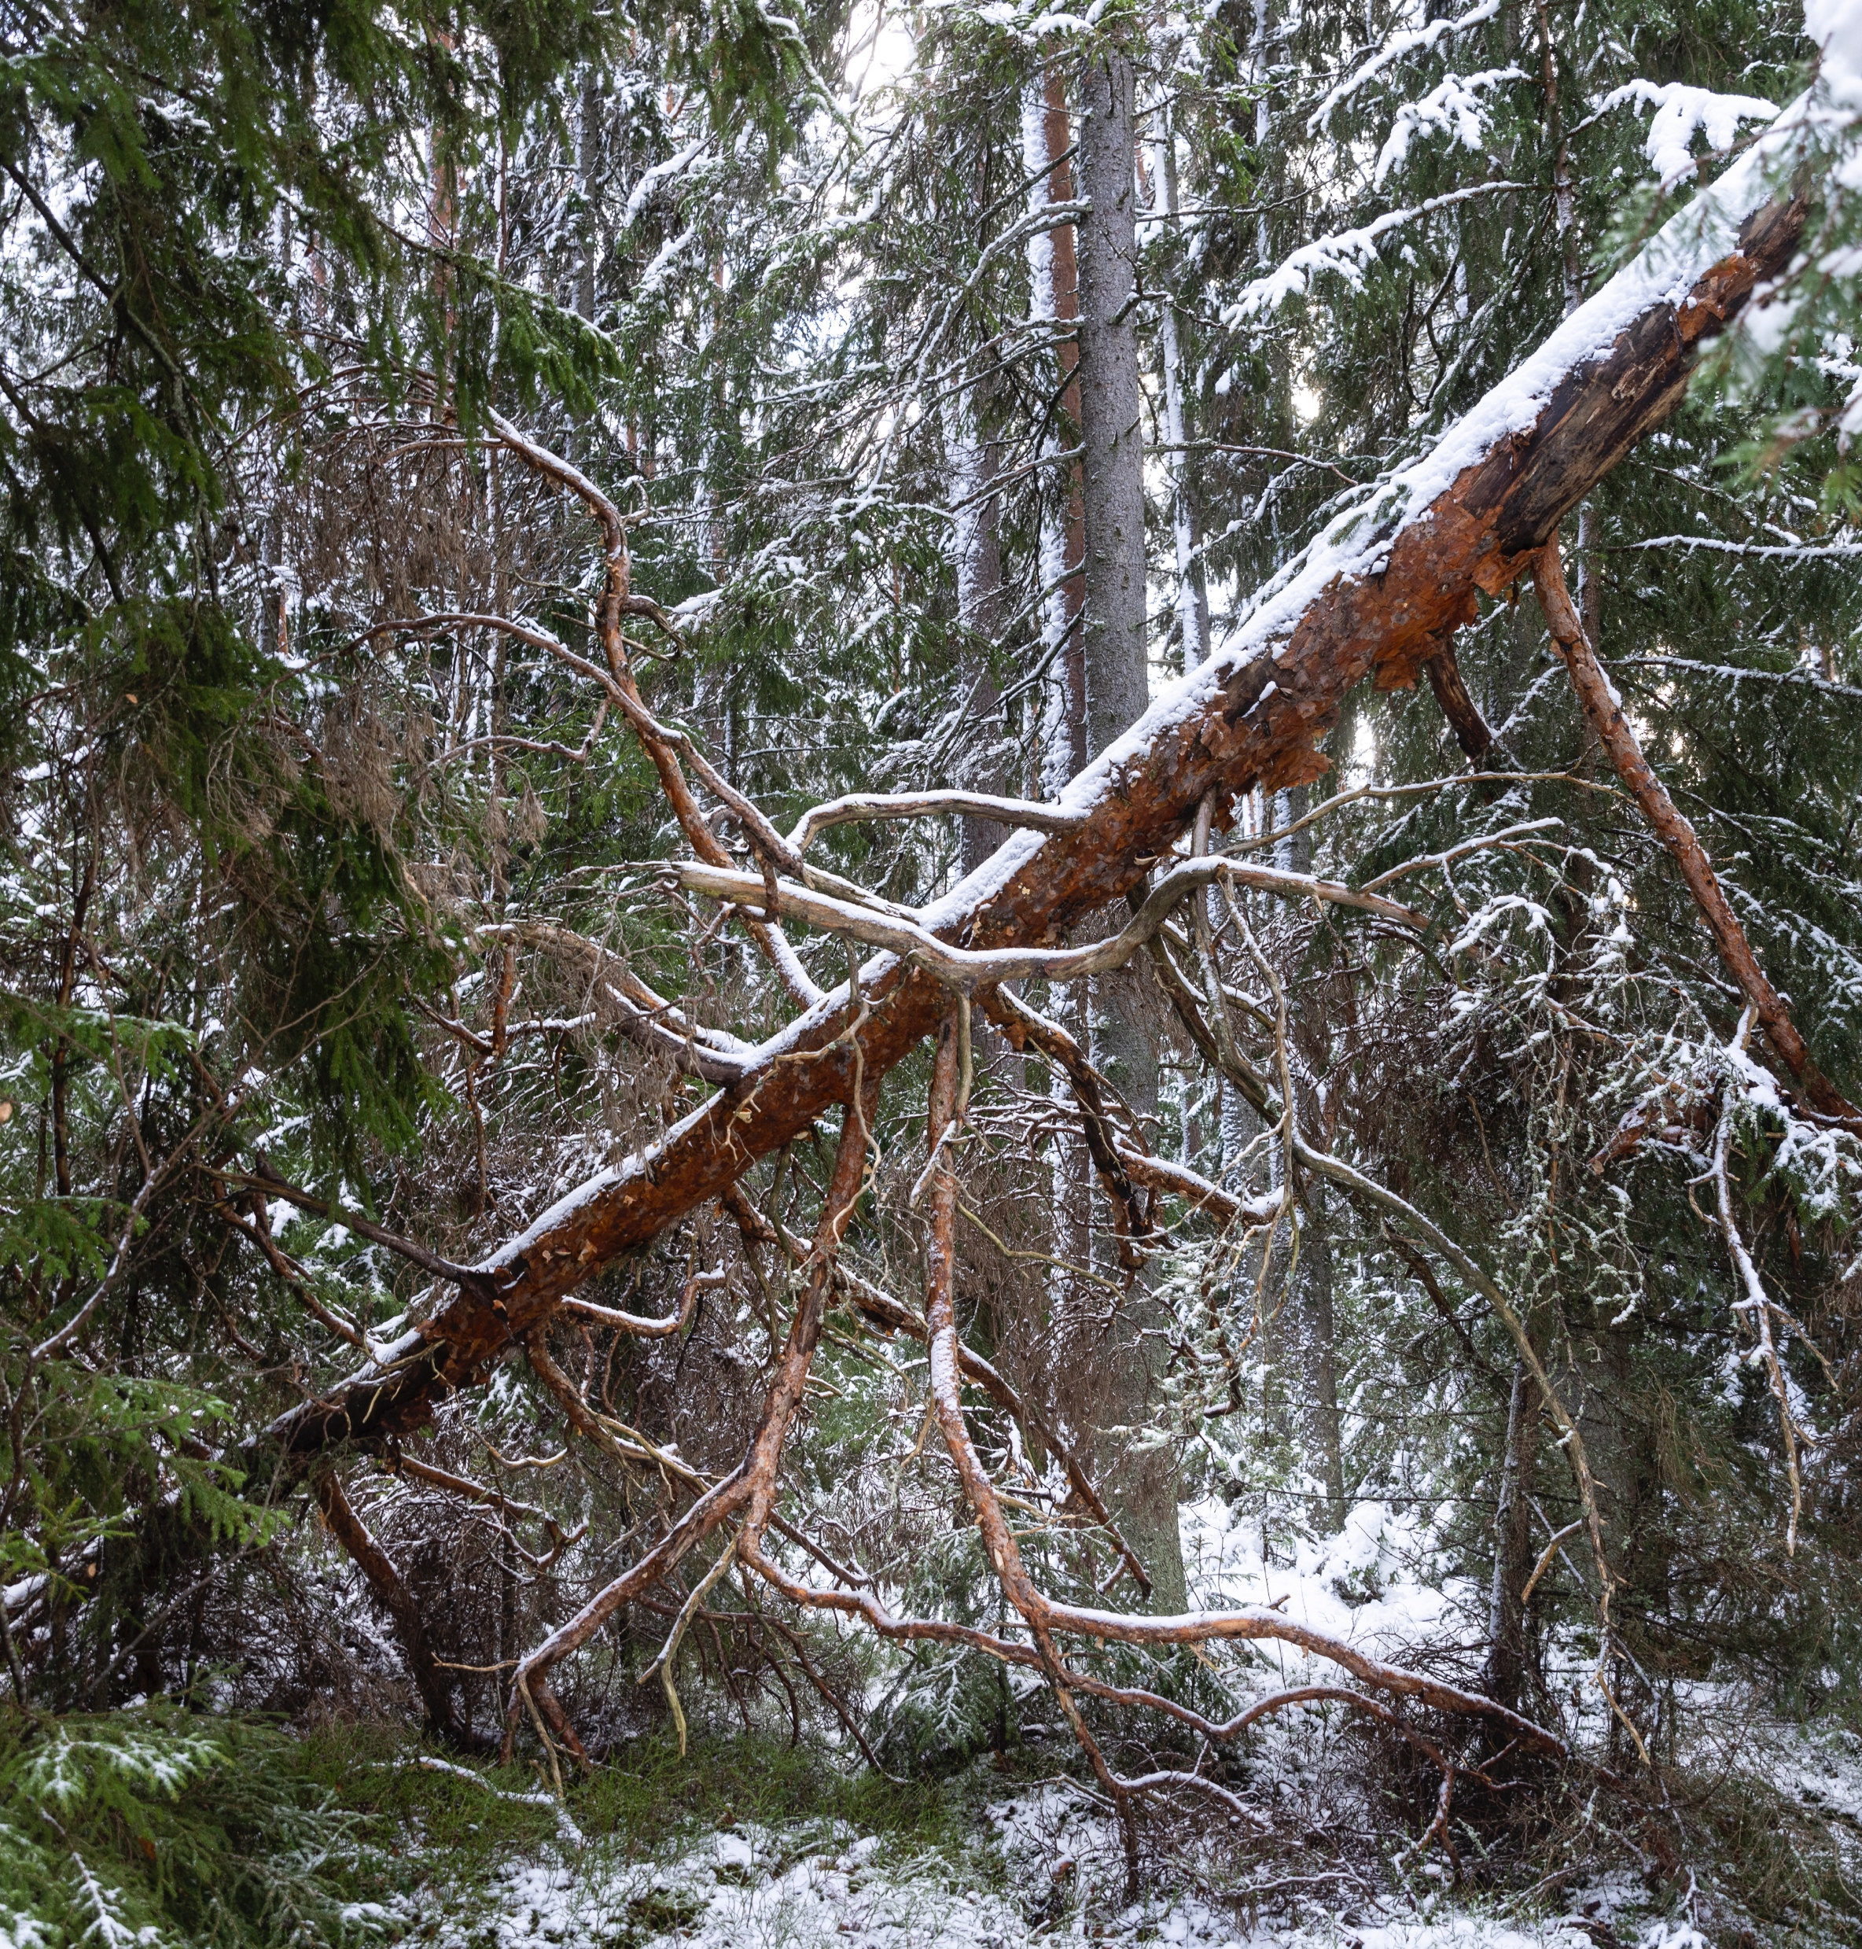
Thank you for organising a discussion for the Great Forest Dialogue Day!
We hope the experience has been rewarding for you.
Please submit your notes from the discussion as soon as possible using the form on the event page.
You can find the form here.
We will read and analyse all the discussion notes as one big dialogue and use them to draw up a summary and alternative scenarios for the future of forests!

